Slide 1
Processing arsenical copper sulphide ores
Dr. Laurence Dyer

Slide 2
Non-arsenical ores
Historically, copper sulphides have been simple to process
The minerals float easily
Concentrate is smelted
Relatively pure copper is produced

Slide 3
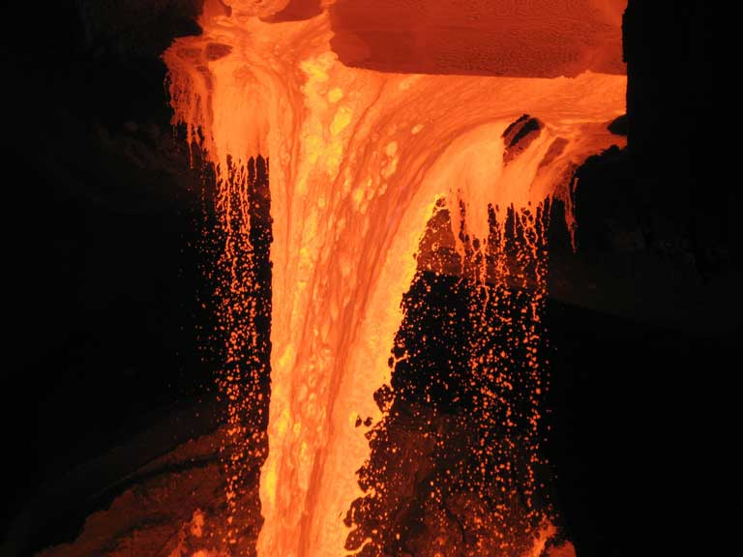
Smelting in more detail
Stage 1: Copper sulphide concentrate (CuS, CuFeS₂, impurities) are added to a furnace with some air
Impurities are oxidised forming a slag,
sulphide matte contains Cu & Fe
Matte is fed into converter with air,
lime and silica
Fe, Si, Ca, Mg oxide slag formed,
sulphur released as SO₂

Slide 4

Chemistry
First reaction:
Either copper is reduced from II to I or iron from III to II, ferrosillicate formed along with sulphur dioxide
Additional air:
Resulting copper is ~98 % pure
$${CuFeS}_{2}+{SiO}_{2}+O_{2} { Cu}_{2}S+{2FeSiO}_{3}+{3SO}_{2}$$
$$O_{2}+{Cu}_{2}S  2Cu+{SO}_{2}$$

Slide 5
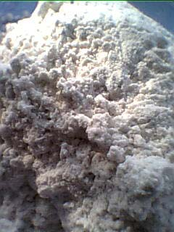
Add arsenic
Arsenic from copper smelting is mining’s largest contribution of As pollution
Smelting converts relatively insoluble As minerals into soluble compounds
Arsenic compounds expelled in off-gas (As₃O₅) and slag (As₂O₃)
Smelters charge penalties for As and will not process material with >0.5 %

Slide 6
Arsenic occurrences
Most copper sulphides contain iron sulphides like pyrite (FeS₂)
Arsenopyrite (FeAsS) is a common alteration of pyrite
Several enargite (Cu₃AsS₄) deposits have been discovered
These are particularly common in South America
As can range from insignificant to 10 % of the concentrate

Slide 7
So what do we do?
Hydrometallurgy is the only remaining option
Copper sulphides are notoriously difficult to leach (refractory)
Options:
  Pre-leaching arsenic
  Copper leaching technology

Slide 8
Pre-leaching arsenic
Alkaline sodium sulphide leach applied to enargite
Arsenic selectively solubilised
Copper remaining as Cu_{1.5}S
Can also solubilise some gold from Au-bearing material

Slide 9
Hydrometallurgical options
Pressure oxidation
Most common hydromet approach to copper sulphides
High temperatures (in excess of 150 °C), thus high pressure
Combines sulphuric acid, ferric ions and oxygen to oxidise the concentrate

Slide 10
Pressure oxidation
Additional expense of elevated temperature
Requirement of autoclave
High oxygen usage species fully oxidised under harsh conditions
General reaction:
$${Cu}_{3}{AsS}_{4}+\frac{35}{4}O_{2}+\frac{5}{2}H_{2}O→3{Cu}^{2+}+{AsO}_{4}^{3−}+{4SO}_{4}^{2−}+{5H}^{+}$$

Slide 11

Fe(III)/Fe(II) couple
Fe(III)/Fe(II) couple used for charge transfer
Regenerated by oxygen addition
Actual oxidation:
$${Fe}^{3+}+e^{−}{Fe}^{2+}$$
$${4Fe}^{2+}+{4H}^{+}+O_{2}{4Fe}^{3+}+{2H}_{2}O$$
$${Cu}_{3}{AsS}_{4}+{20H}_{2}O+{35Fe}^{3+}{3Cu}^{2+}+{AsO}_{4}^{3−}+{3S}^{0}+{SO}_{4}^{2−}+{40H}^{+}{35Fe}^{2+}$$

Slide 12

Fe(III)/Fe(II)
Regeneration of Fe(III)
Iron cancels in overall equation, same result achieved
$${35Fe}^{2+}+{35H}^{+}+\frac{35}{4}O_{2}→{35Fe}^{3+}+\frac{35}{2}H_{2}O$$
$${Cu}_{3}{AsS}_{4}+{\frac{5}{2}H}_{2}O+{35Fe}^{3+}+{35Fe}^{2+}+\frac{35}{4}O_{2}→{3Cu}^{2+}+{AsO}_{4}^{3−}+{3S}^{0}+{SO}_{4}^{2−}+{5H}^{+}+{35Fe}^{2+}+{35Fe}^{3+}$$
$${Cu}_{3}{AsS}_{4}+{\frac{5}{2}H}_{2}O+\frac{35}{4}O_{2}→{3Cu}^{2+}+{AsO}_{4}^{3−}+{3S}^{0}+{SO}_{4}^{2−}+{5H}^{+}$$

Slide 13

Pressure Oxidation
Lower temperatures are more oxygen efficient but rate and recovery suffer
Ferric ions are present and precipitate with generated arsenate
Solid is generally very stable and can be expelled with waste
Consumes ferric ions from solution (slows oxidation)
Ideally
$${Fe}^{3+}+{AsO}_{4}^{3−}{FeAsO}_{4}.{2H}_{2}O$$

Slide 14

Pressure Oxidation
Needs to supply ferric ions to precipitate arsenic
Dissolution of iron-bearing minerals required
Oxidation of pyrite likely source
Further consumption of oxygen
$${2FeS}_{2}+{\frac{15}{2}O}_{2}+H_{2}O→{2Fe}^{3+}+{4SO}_{4}^{2−}+{2H}^{+}$$

Slide 15

Overall reaction
Thus there are three reactions occurring
  Enargite dissolution
  Pyrite dissolution
  Ferric arsenate precipitation
$${2Cu}_{3}{AsS}_{4}+\frac{35}{2}O_{2}+{5H}_{2}O→6{Cu}^{2+}+{2AsO}_{4}^{3−}+{8SO}_{4}^{2−}+{10H}^{+}$$
$${2FeS}_{2}+{\frac{15}{2}O}_{2}+H_{2}O→{2Fe}^{3+}+{4SO}_{4}^{2−}+{2H}^{+}$$
$${Fe}^{3+}+{AsO}_{4}^{3−}+{2H}_{2}O{FeAsO}_{4}.{2H}_{2}O$$
$${Cu}_{3}{AsS}_{4}+{FeS}_{2}+\frac{25}{2}O_{2}+{5H}_{2}O→3{Cu}^{2+}+{FeAsO}_{4}{.2H}_{2}O+{6SO}_{4}^{2−}+{6H}^{+}$$

Slide 16
CESL Process
The CESL process involves the addition of chloride ions to the pressure leach system
150 °C, 0.3 M Cl⁻
This creates more oxidising conditions and increases reaction rates
Iron minerals dissolve more readily
FeAsO₄ is generally stable

Slide 17
Biological oxidation
Several species examined:
  Sulfolobus BC
  As-tolerant acidithiobacillus ferooxidans
  Thermophiles
Also conducted in the sulphuric acid, ferric ion system
Reasonable enargite extraction achieved

Slide 18
Biological oxidation
Kinetics are slower than pressure oxidation
Cheaper and more reagent efficient, generates elemental sulphur
Showed some preference for other sulphide minerals (pyrite)
May create different arsenate ions, which may lead to unstable products

Slide 19
Atmospheric Leaching
Similar to process to pressure oxidation
Major difference is temperatures range from 60-90 °C
This creates slower kinetics and different products
Tends to form more elemental sulphur than sulphate
Therefore there is a saving in both reagents and energy

Slide 20
Atmospheric leaching
Reagent and energy saving:
Elemental sulphur generation saves a lot of oxygen
$${Cu}_{3}{AsS}_{4}+\frac{17}{2}O_{2}+H^{+}→{3Cu}^{2+}+{AsO}_{4}^{3−}+{3S}^{0}+{SO}_{4}^{2−}+{9H}_{2}O$$
Including pyrite oxidation for ferric arsenate precipitation
$${Cu}_{3}{AsS}_{4}+{FeS}_{2}+\frac{13}{2}O_{2}+{2H}^{+}+H_{2}O→{3Cu}^{2+}+{FeAsO}_{4}.{2H}_{2}O+{4S}^{0}+{2SO}_{4}^{2−}$$

Slide 21
GalvanoxTM
Uses the galvanic interaction between pyrite and chalcopyrite to achieve viable copper dissolution
Electrical contact aids charge transfer
Cu²⁺
Fe³⁺
AsO₄³⁺
Fe²⁺

Slide 22
Passivation
Elemental sulphur is an insulator
Formation of a layer of sulphur on the enargite surface impedes the reaction
S⁰
Cu²⁺
Fe³⁺
AsO₄³⁺
Fe²⁺

Slide 23
Passive Layer
Very difficult for ions/electrons to diffuse through passive layer
✗
Fe³⁺
✗
Fe²⁺

Slide 24
Passivation
Passivation slows or stops leaching
Rate change to control by diffusion
through passive layer

Slide 25
Avoiding passivation
3 Major methods to avoid passivation
More oxidising conditions to oxidise sulphur (excess reagent use)
Fine grinding: Smaller particles are less affected by passivation
Increasing conductivity of layer
  Achieved in literature by addition of activated carbon or silver-bearing pyrite

Slide 26
Arsenic precipitation
FeAsO₄ precipitation is dependent on pH, temperature and saturation
Control of free acid provides better control of reaction
Still subject to precipitation events when
supersaturation is reached
Use of seed material provides better
control and larger particles

Slide 27
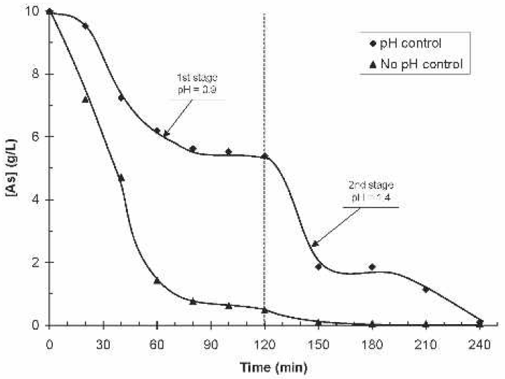
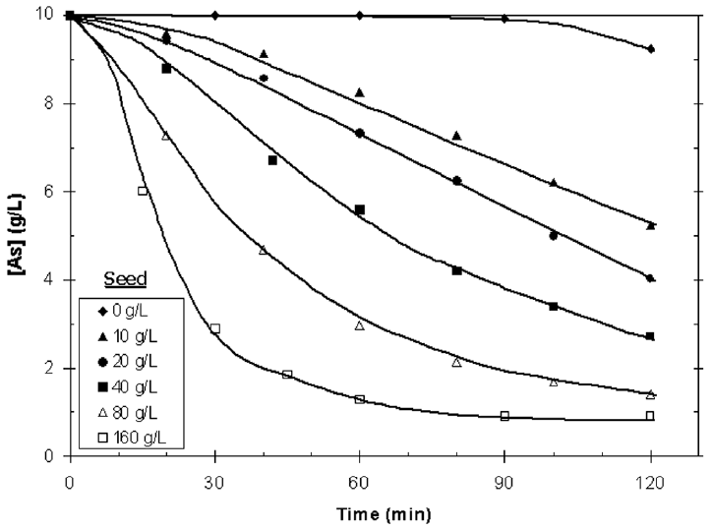
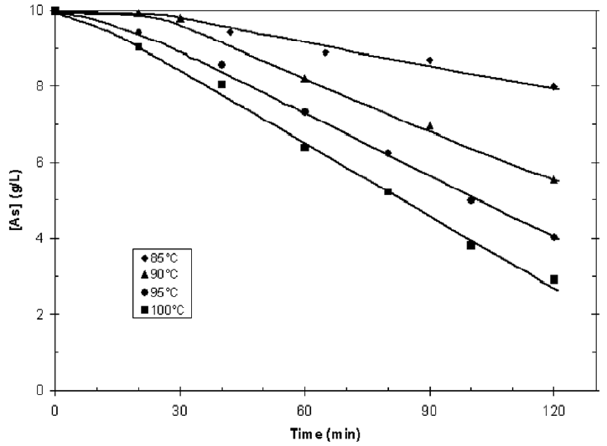
Arsenic Precipitation
A combination of high temperature, low free acid and the presence of seed provide the lowest residual arsenic concentration
Singhania, et. al., 2005 & Singhania, et. al., 2006

Slide 28
References
http://www.mcc.com.cn/mccen/focus/_325423/347090/index.html
http://www.yogeshchemicals.com/arsenic-trioxide.htm
S. Singhania, Wang, Q., Filippou, D., Demopoulos, G. P., Metallurgical and Materials Transactions B., 2005, 36B, 327-333.
S. Singhania, Wang, Q., Filippou, D., Demopoulos, G. P., Metallurgical and Materials Transactions B., 2006, 37B, 189-197.

